Slide 1
SGGSJ GOVT.COLLEGE
Software Process Model
(BCA / PGDCA)

Slide 2
What is a Software Process Model?
Software Processes is a coherent set of activities for specifying, designing, implementing and testing software systems. A software process model is an abstract representation of a process that presents a description of a process from some particular perspective. There are many different software processes but all involve:
Specification – defining what the system should do;
Design and implementation – defining the organization of the system and implementing the system;
Validation – checking that it does what the customer wants;
Evolution – changing the system in response to changing customer needs.

Slide 3
Types of Software Process Model
Waterfall model
V model
Incremental model
RAD model
Agile model
Iterative model
Spiral model
Prototype model

Slide 4
Waterfall Model
The waterfall model is a breakdown of project activities into linear sequential phases, where each phase depends on the deliverables of the previous one and corresponds to a specialisation of tasks.
The approach is typical for certain areas of engineering design.

Slide 5
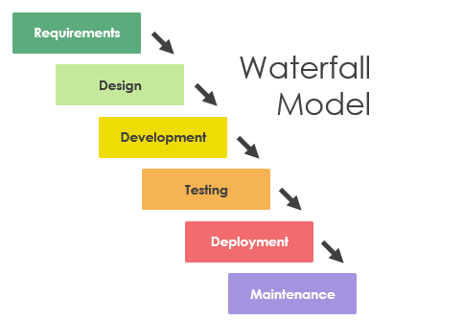

Slide 6
V Model
The V-model represents a development process that may be considered an extension of the waterfall model and is an example of the more general V-model. Instead of moving down in a linear way, the process steps are bent upwards after the coding phase, to form the typical V shape.
The V-Model demonstrates the relationships between each phase of the development life cycle and its associated phase of testing.

Slide 7
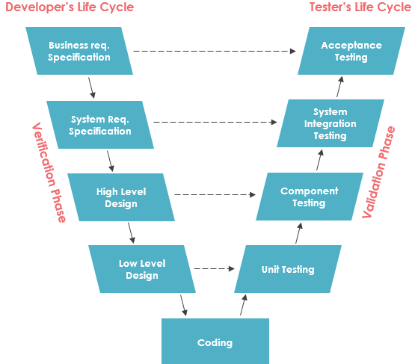

Slide 8
Incremental model
The incremental build model is a method of software development where the model is designed, implemented and tested incrementally (a little more is added each time) until the product is finished.
It involves both development and maintenance. The product is defined as finished when it satisfies all of its requirements.
Each iteration passes through the requirements, design, coding and testing phases.

Slide 9
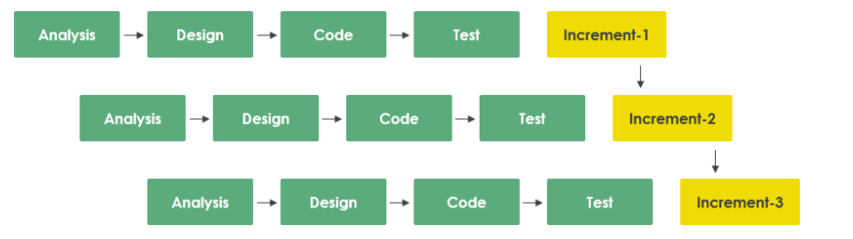

Slide 10
Iterative Model
An iterative life cycle model does not attempt to start with a full specification of requirements by first focusing on an initial, simplified set user features, which then progressively gains more complexity and a broader set of features until the targeted system is complete.
When adopting the iterative approach, the philosophy of incremental development will also often be used liberally and interchangeably.

Slide 11
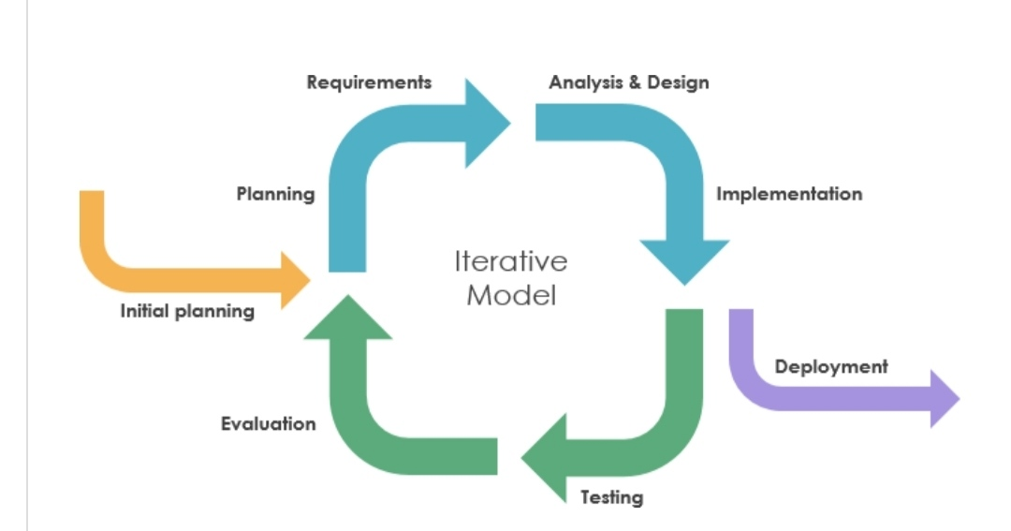

Slide 12


